Slide 1
October 12, 2021
Annual Members’ Meeting

Slide 2
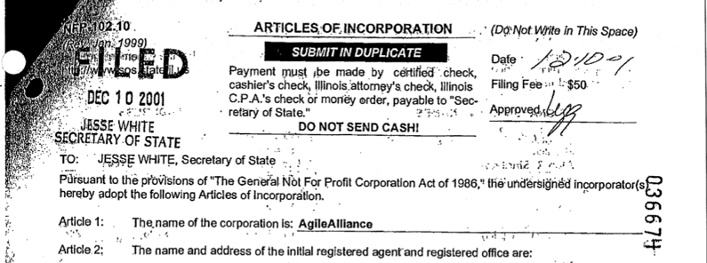
Happy Anniversary Agile Alliance!

Slide 3
Agenda
Board of Directors Election Results
2021 in Review
Financial Reports
What’s Coming in 2022
How You Can Support Agile Alliance

Slide 4
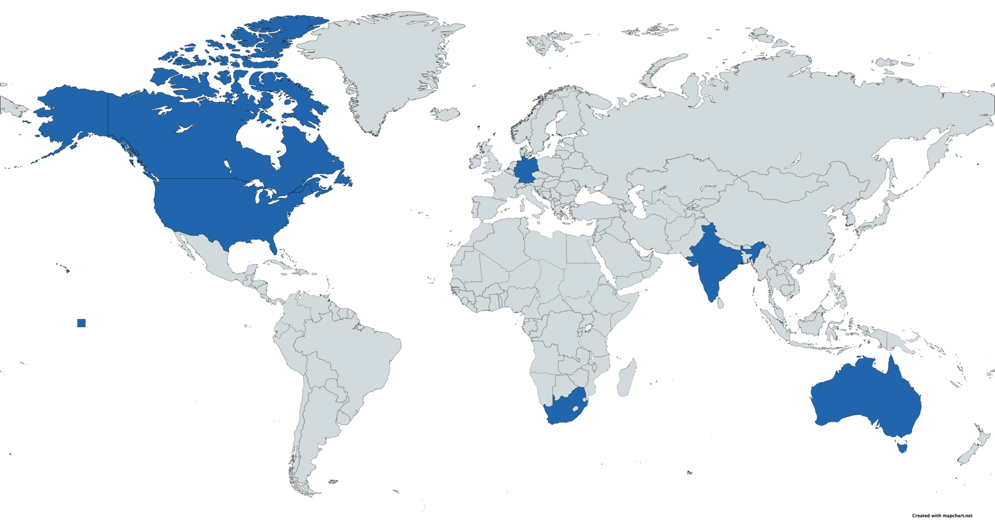
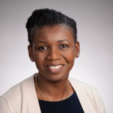
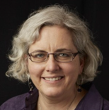
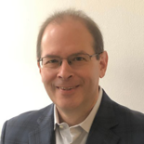
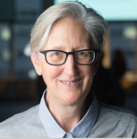
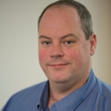
Board of Directors 2021

Slide 5
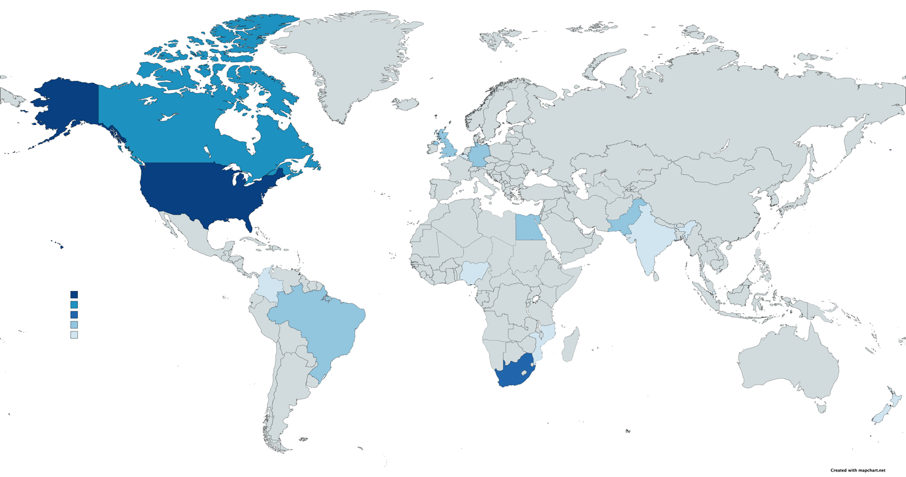
Nominations by Country
16
4
3
2
1

Slide 6
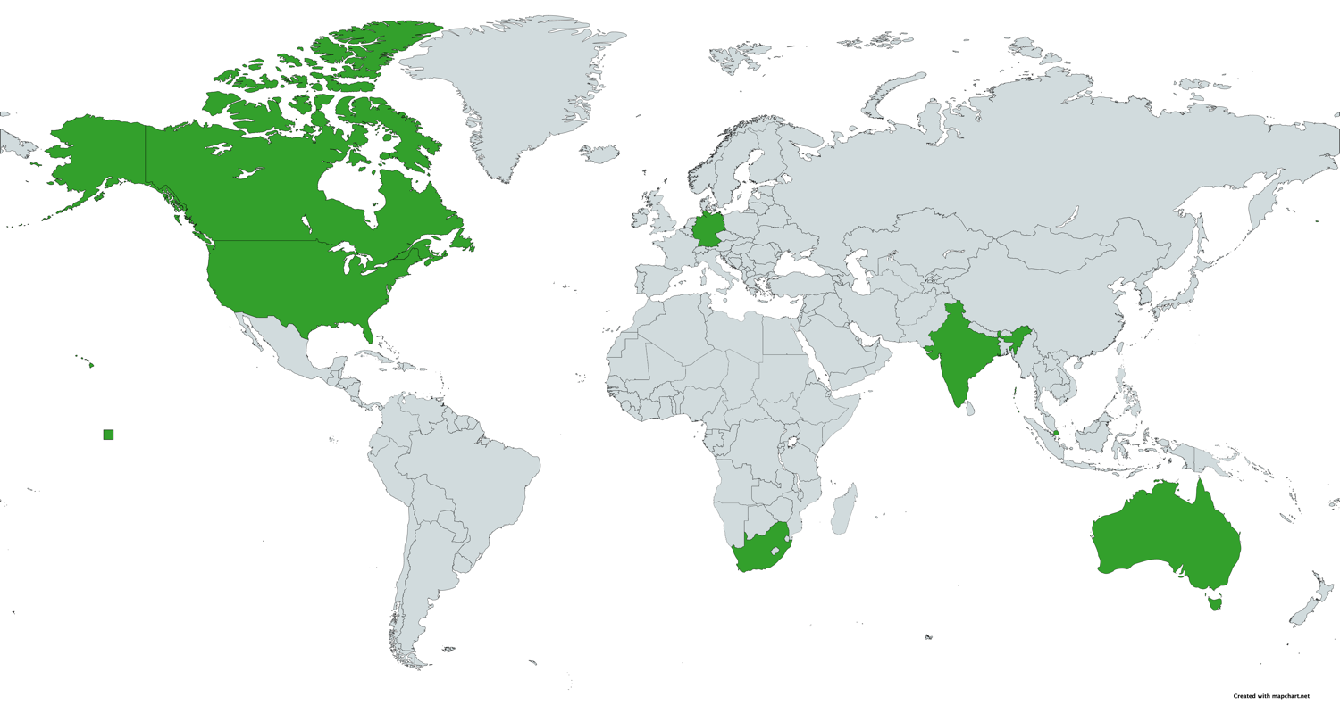
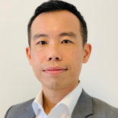
Board of Directors 2022

Slide 7
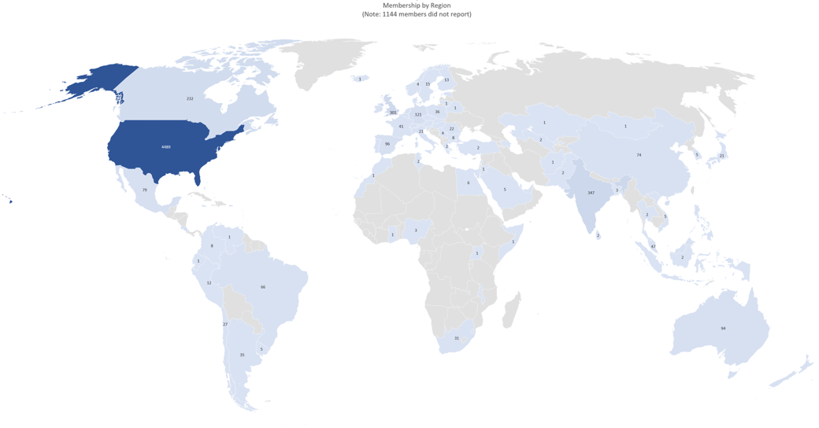
Agile Alliance Membership
7600 members worldwide
2500 individual
5100 corporate
Notes:
By Geo:
4900 North America
700 Europe
450 APAC
150 South America
50 Africa

Slide 8
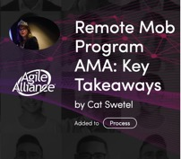
2020/2021 Event Programming
+ videos, blogs, experience reports, podcasts

Slide 9
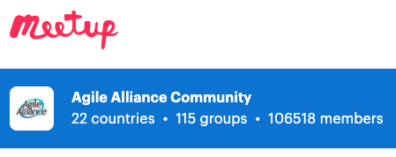
2020/2021 Initiatives
…and more!

Slide 10
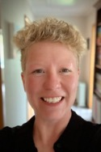
Agile Alliance New Zealand
Supporting the growth of the Agile mindset through the industry in New Zealand, with particular emphasis on areas which are currently underserved (geographic areas as well as industries)
Ant Boobier
Chair
Sandy Mamoli
Secretary
Charlotte Hinton
Treasurer

Slide 11
Agile Alliance NZ Activities
2020/2021
Holding pattern, supporting local meetup groups
2021/2022
Continuing support for local Meetup groups
Agile Christchurch 2022 and Regional conferences
International speakers online in NZ
Agile New Zealand plans…!
Notes:
Like the rest of the world we have been impacted by COVID-19, and most events have moved from in-person to remote, online. New Zealand came out of lock-down in May and we are seeing a slow recovery of in person events.
We have worked at supporting the local community in the regions and now have a new local Meetup group in Palmerston North.
For 2020/21 we plan on continuing the support for local events both in person and remote, and won’t launch any significant new initiatives until 2021.
We are not putting on a large conference this year, we do plan to run a national conference for ~500 people in October 2021

Slide 12
Agile Alliance Brazil

Slide 13
Financial Reports Heidi Musser Treasurer

Slide 14
Financial Health

Slide 15
PPP Loan

Slide 16
Community Initiatives

Slide 19
Agile2021

Slide 20
Membership

Slide 21
Financial Summary

Slide 22
Outlook

Slide 23
#EmbraceChange
#AgilityMatters

Slide 24
What’s Coming Up in 2022 – Member Programming

Slide 25
What’s Coming Up in 2022 - Events
Kevin Stevens
Agile2022 Conference Chair

Slide 26
How Can You Support Agile Alliance
Renew your membership and encourage others to join
Help us build corporate membership and sponsorship
Promote events and activities—amplify social media

